Slide 1
Base Layer Controller Assessment (BLCA)
MBU APC Spin Off Learning Mini Series #4
Presentation to EAS Process
DD.MM.YY
The PETRONAS Group adopts zero tolerance against all forms of bribery and corruption. We abide by the PETRONAS Code of Conduct and Business Ethics (CoBE) & Anti-Bribery and Corruption (ABC) Standard, guided by our Shared Values, PETRONAS 2.0 Desired Behaviours and Statement of Purpose.

Slide 2



What is Base Layer Controller Assessment (BLCA)?
A systematic technique that determine:
The overall health of PID control loop
Identify non-compliance loop & the potential root cause:
  Faulty instrumentation
  Incorrect control strategies
  Improper tuning settings
  Process design limitation
Potential improvement for the non-performing controller

Slide 3
BLCA Objectives
Objectives
To check the present mode of controllers (Auto/Manual/Cascade) against
the design and intended operating mode
To identify and consolidate the reasons for controllers not operating in the
correct mode, i.e. controller in manual, disconnected slave controller.
To evaluate and measure the performance of automatic controller through
data analysis
To measure the quality of process variable (noise)
To identify faulty control valves and measurement transmitters through data
analysis
To quantify the overall performance of base layer controllers for readiness
of Advanced Process Control implementation

Slide 4
Training Outline

Slide 5
Simplified Methodology
Process Understanding & Data Collection
Data Analysis
Information Consolidation and Controller Assessment
BLCA Recommendation & PIMS assessment
PFD & Process Description
P&ID
DCS Graphic
Control narratives
List of associated controllers within BLCA/ APC boundary (may comprises the advanced regulatory controller) & indicators.
Data at least 2 weeks (at internal 1 min).
Controller’s mode
  CAS / Auto
  Manual
Controller’s Status
  Compliance
  Non-compliance
Controller’s Performance
Indicator Performance
  Bad PV
  Noisy
Interview with operator & instrument technicians for:
  Process constraints
  Instrumentation issues
  Operation of controllers & process units
Performance Analysis using tools (MDPro).
Trend observations
Determine Controller’s Performance (Poor / Good)
Propose improvement recommendation for rectification such as:
tuning,
instrumentation rectification and
Control Strategy Improvement

Slide 6
Methodology
1
Process Understanding
Obtain process information through process description, P&ID, PFD, DCS graphics, list of controllers.
Establish rapport with important personnel for information gathering, i.e. process technologist , panel man, DCS & Instrument engineers

Slide 7
Methodology
2
Data Collection
Remove data compression from PIMS.
Collect a month/minimum of 1 to 2 weeks data at maximum of 1 minute interval.
Collect data at normal plant operating load.
Ensure all tags are configured, historised and can be extracted from PIMS.
Tags required from PIMS are
  FOXBORO : MEAS, SPT, OUT, MODE
  YOKOGAWA : PV, SV, MV, MODE
  HONEYWELL: PV, SP, OP, MODE

Slide 8
Methodology
3
Data Reconciliation, Clean & Data Segregation
Remove tags with no value or with bad inputs
Remove repeated tags before importing data into application/tools
Replace and equalize data with negative values to equal zero
Segregate/List controllers in manual mode and automatic mode
Segregate/List cascade, split range, ration and override controllers
Segregate/List of batch controllers/start up/shut down controllers
Segregate/List on/off/non regulating controllers from automatic controllers (Controller output remained at one position)

Slide 9
Methodology
4
Data Analysis and Controllers Performance Rating
Carry out data analysis on automatic controllers with varying measure value, set point and output. Set point can be fixed but it is better to analyze data with some set point changes.
Load and analyze data using specific tools, i.e. Excel, Control Station Loop Pro, Shell MD Pro. Different tools have different analysis criteria.
Rate the controller's performance according to the analysis criterion calculated by specific tools according to priority (Safety, Quality, Production), e.g. Ratings of controllers: Very Good, Good, Fair, Poor .
Example: Controller performance assessment criterion using Shell MD Pro are tabulated in the next slides

Slide 10
Controller Performance Rating
No | Analysis Criteria (MD Pro) | Magnitude | Ratings
1 | Standard Deviation on Error | Good | Very Good Good Fair Poor
2 | Minimum Standard Deviation on Error Generated by PCTP MD PRO | Closer to Item 1 the better
3 | Settling time for PV and MV | Fast
4 | Controller Performance Index (CPI) Generated by SHELL MD PRO | Fast ( between 0-1)
5 | Standard Deviation on MV | Good
6 | % MV moves | Good
7 | Magnitude of noise | Good Where: X% = Stdev PV/ Avg PV x% > 5% (High) 3% < x% < 5% (Low) x % < 3% (Negligible)
8 | PV and MV Oscillation | Oscillation, may indicate tight tuning settings

Slide 11
Methodology
4
Data Analysis and Controllers Performance Rating
Apart from statistical method, the performance can also be evaluated qualitatively through trend observation and interpretation, e.g. PV & MV Oscillation & measurement quality/noise.
From the analysis, identify controllers which may require tuning, with noisy measurement and instrumentation limitation, i.e. over sized or undersized control valve, control valve, hysterisis & stiction
Note:
Data analysis cannot be carried on saturated controller (Controller output at 0% or 100%)
– on/off controllers where set points are changed to force the control valve to fully close or open position.
– undersized control valve whereby the control valve is already fully open or close without achieving its set points. (Controller Output saturated 0% or 100%)
Good understanding on controller performance assessment criterion are essential.

Slide 12
Methodology
5
Identify and consolidate reasons for non-conformance controller
List down non-compliance controllers. i.e. manual controllers, controllers with incorrect operating mode.
Interview panel operators from several shifts and gather information from Operations Engineers & technologist and Instrument Engineers.
Record the reasons on a spreadsheet.
Check whether manual controllers have setpoint tracking functions. (Can be analyze from data)
Note:
  It is crucial to interview operators from different shifts and verify the information with engineers. This to ensure that the reasons make sense and consistent

Slide 13
Methodology
6
Identify and consolidate reasons for non-conformance controller
From Step 5, study the root cause for controllers for operating in manual and identify controllers with incorrect strategy.
Give recommendations with sound understanding on process dynamics and limitations.
Identify controllers which require review in process design. This is to ensure that a correct control strategy can be recommended
Note:
  Recommendations on control strategy can only be proposed and will only function with a valid process design.

Slide 14
Methodology
7
Identify and consolidate reasons for non-conformance controller
Gather information from Operations, Process Technologist and Instrument Engineers to prioritize the criticality of controllers based on process requirements.
Prioritize the controllers into 3 categories (High, Medium, and Low). The following criteria determines the importance of controllers with respect to process requirements in descending order. For example, the controller’s priority is automatically rated as high if safety is jeopardized.
  Safety
  Quality
  Production Rate
  Opportunity loss
Note:
  Prioritization of controllers allow systematic corrective actions to be taken during improvement initiatives, in which attention shall be given to controllers in descending priority (High, Medium & Low).

Slide 15
Controller Performance Assessment Techniques

Slide 16
Understanding Controller Performance Assessment Techniques
As mentioned in Step 4, the understanding of controller performance assessment criteria is very crucial. These techniques can be divided into
  Quantitative techniques based on statistical methods
  Qualitative techniques based on observation and experience
Some of the methods are listed below:
  a. Deviation (Error) caused by Set-Point Changes (SSE,ISE, IAE,
  ITAE)
  b. Variance (Standard Deviation) on error or MV
  c. Decay Ratio
  d. % Overshoot
  e. Settling Time
  f. Measurement Noise
  g. % of MV moves
  h. Control Valve Characteristic

Slide 17
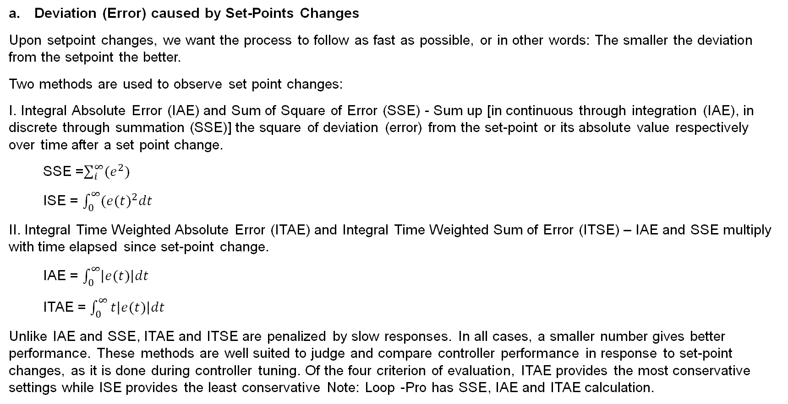
Understanding Controller Performance Assessment Techniques
Deviation (Error) caused by Set-Points Changes
Upon setpoint changes, we want the process to follow as fast as possible, or in other words: The smaller the deviation from the setpoint the better.
Two methods are used to observe set point changes:
I. Integral Absolute Error (IAE) and Sum of Square of Error (SSE) - Sum up [in continuous through integration (IAE), in discrete through summation (SSE)] the square of deviation (error) from the set-point or its absolute value respectively over time after a set point change.
  SSE =$\sum_{i}^{∞}{(e^{2})}$
  ISE = $\int_{0}^{∞}{(e{(t)}^{2}dt}$
II. Integral Time Weighted Absolute Error (ITAE) and Integral Time Weighted Sum of Error (ITSE) – IAE and SSE multiply with time elapsed since set-point change.
  IAE = $\int_{0}^{∞}{\left|e(t)\right|dt}$
  ITAE = $\int_{0}^{∞}{t\left|e(t)\right|dt}$
Unlike IAE and SSE, ITAE and ITSE are penalized by slow responses. In all cases, a smaller number gives better performance. These methods are well suited to judge and compare controller performance in response to set-point changes, as it is done during controller tuning. Of the four criterion of evaluation, ITAE provides the most conservative settings while ISE provides the least conservative Note: Loop -Pro has SSE, IAE and ITAE calculation.

Slide 18
Understanding Controller Performance Assessment Techniques
Variance (Standard Deviation)
The above method is not suitable for on-line performance monitoring and also, for judging disturbance handling. In this case, calculating and monitoring the variance (Standard Deviation), the average deviation and the mean value of variable is much more effective. The smaller the standard deviation the better. Standard deviation can be applied on error, PV & MV
Note:
  MDPro has min standard deviation on error, min standard deviation is derived from ideal model where process model & disturbance model are segregated.

Slide 19
Understanding Controller Performance Assessment Techniques
Decay Ratio
Peak 2 divided by Peak 1 from Set Point or the ratio of two successive peaks of a damped oscillation. The smaller the number the better. DC = b/a
% Overshoot
Peak 1 divided by Set Point multiply by 100%. The smaller the number the better. O = a / SP x 100%
Settling Time
Time required for the PV to reach and remain inside a band whose width is equal to plus minus 5% of the
total change in step change (95% of response time). The faster the PVs settle the better but does not
necessary mean slow is bad.
a
b

Slide 20
Understanding Controller Performance Assessment Techniques
Measurement Noise
Noise to signal ratio of more than 5% is considered nuisance. Error on set point and standard deviation may be contributed by noise.
Noise to Signal Ratio = Standard Deviation on PV / Average PV
Hence, it may be necessary to filter out the noise to improve controller performance by reducing unnecessary controller action on MVs or control valve. However, it is important to check & fix the measurement devices before any filtering can be done. Faulty transmitter may be the source of the noise
% of MV move
A tight or aggressive controller will result in faster, frequent and larger MV moves. Such movement will contribute to the wear and tear of the final element in the long run. This criteria is used to measure the frequency and movement of the final element, i.e. control valve.
Control Valve Characteristic
The trend of the PV, SP and CV could give a good picture on whether the valve is sticky. If PV does not change and maintain at a certain value for a short period of time and then suddenly change later, this may be caused by stickiness of the valve.

Slide 21
Examples of
Base Layer Control Analysis

Slide 22
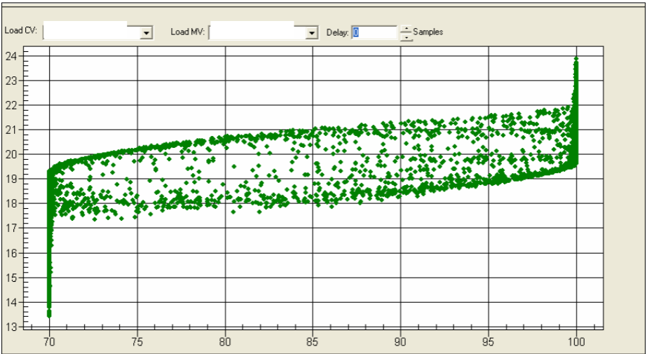
Control Valve Characteristics
Control Valve Hysteresis (Pressure Controller - Valve B acts between 70% - 100%)

Slide 23
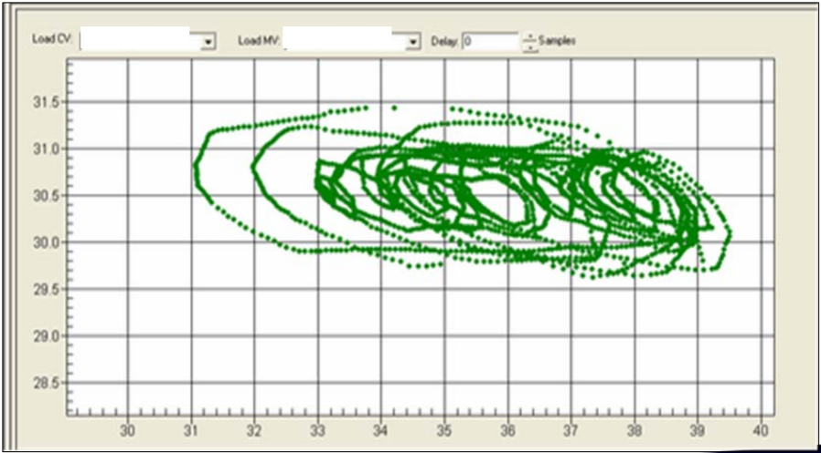
Control Valve Characteristics
Sticky Valve and Oscillating (Pressure Controller)

Slide 24
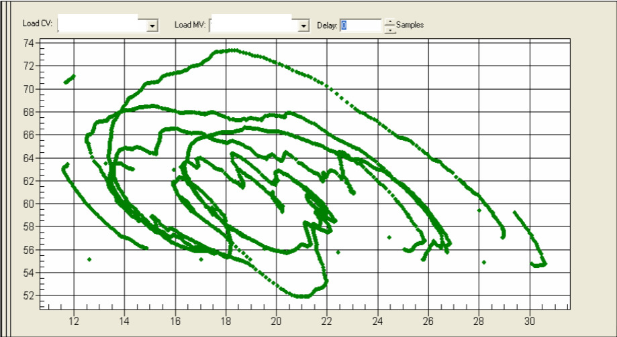
Control Valve Characteristics
Abnormal Behavior (Level Controller)

Slide 25
Control Valve Characteristics
Abnormal Behavior (Level Controller)

Slide 26
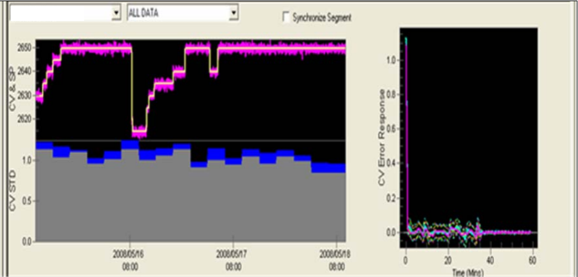
Examples of Good and Bad Performing Controllers using MDPro
Good Performing Controllers (Pressure Controller)

Slide 27
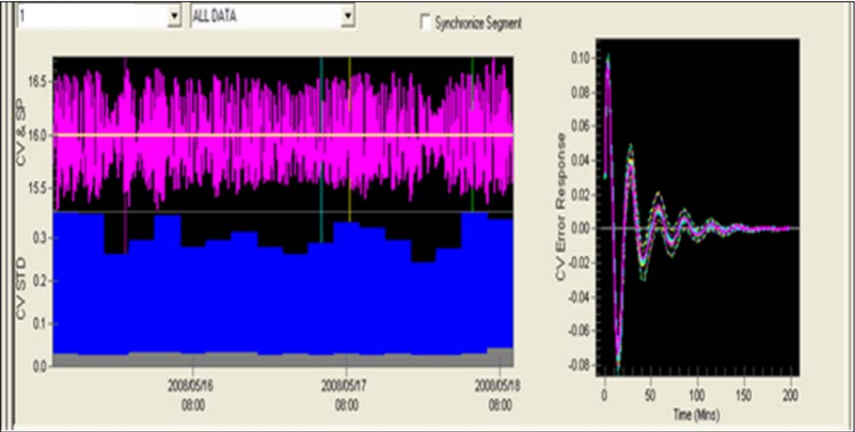
Examples of Good and Bad Performing Controllers using MDPro
Poor Performing Controllers (Pressure Controller)

Slide 28
Best Practices

Slide 29
Best Practice: Data Reconciliation
Always ensure good quality data is used for analysis.
Data compression must be removed.
Perform systematic data cleaning by removing all data with bad inputs or with value that does not make sense.
The size data will reduce after data reconciliation. Since a minimum of 3 days at maximum of 1 minute interval data is required for analysis, ensure that data of more than 3 days are collected. (1 to 2 weeks)
Ensure all tags have same time stamp. If one tag is removed, ensure other tags with the same time stamp are removed too.
Replace negative value with zero value.
Do not edit the original data file. Save it as back up for reference.
Remove duplicated tags.

Slide 30
Best Practice: Data Arrangement
Label the tags systematically with short process description if possible.
Place the same tags for a particular controller adjacent to each other (PV, SP, MV & mode) for easy reference.
Identify the process fluid in the process stream for each controller (steam, gas, liquid, slurry, etc) to ease process understanding, i.e. steam flow will typically gives noisy measurement.
Arrange the tags by units and controller types, i.e. flow controller, pressure controller, temperature controller and level controller.
Ensure data arrangement is in the correct format for uploading. Systematic tags arrangement will ease the uploading of tags into the analysis software. (Shell MDPro, Loop-Pro)
Ensure that data file is saved into correct format. Different software used difference data files types.
Shell MD Pro -: .Excel, Loop-Pro -.Text or .CSV

Slide 31
Best Practice: Data Analysis
Use the best and most suitable tool for analysis. For example, Shell MD pro can perform analysis on data with 1 minute interval while Loop Pro requires data with shorter interval.
Ensure data are of good quality and is sufficient for analysis.
Strong understanding on controller performance analysis criteria is essential i.e. ITAE, IAE, SSE, Decay Ratio, % of MV move, overshoot, Standard deviation on error , minimum standard deviation , stability factor etc.
  This will enable accurate judgment and can verify whether the result generated by the software make sense. Do not depend entirely on the result generated by the software. Engineer’s judgment is more important!
If two or more person are conducting the analysis at one time, ensure that the ratings of criteria are synchronized. This is to avoid rework as analysis may differ from individuals.
Strong understanding on trends interpretation is useful to identify abnormality, i.e.. control valve hysteresis, stiction etc. This can be identified by plotting MV versus PV plot.
Not all oscillating MVs and PVs are caused by wrong tuning. It may be caused by interaction with other controllers. Check whethere there are any interacting controllers in the vicinity.
Controllers with long settling time (Slow) may not be necessary bad. The controller is intentionally tune slow (Sluggish) to suit process behavior.

Slide 32
Best Practice: Results Tabulation
Tabulate all results and observation on a single excel spreadsheets for easy reference. (Result Summary)
For manual controllers, list and record the following:
  Record tag description
  Record process service line, i.e. gas, steam, liquid
  Record reasons for controllers in manual
  Include performance remarks, i.e. non-compliance or compliance.
  Recommend intervention steps to resolve and revert controller to automatic, i.e. change in control strategy.
  Prioritize controller to allow systematic improvement initiative, i.e. high, medium, low.
  Tabulate result in pie charts according to reasons (i.e. In manual due to acceptable reasons, Instrumentation problems, In manual due to in correct operations, etc.)

Slide 33
Best Practice: Results Tabulation
For automatic controllers, list down the following:
  Record Tag description
  Record process service line. i.e. gas, steam, liquid
  Record the trend observation on spreadsheet. i.e. noisy measurement, oscillating, abnormal spike or abnormal behavior.
  Record statistical performance criteria:
      Sum of square of error,
      Standard deviation on error,
      Standard deviation on mv,
      Minimum standard deviation on error,
      % of mv moves,
      Controller Performance Index (Calculated by Software)
      Signal to noise ratio in % or just the ratings of noise - High, Low or negligible (see slide no. 10)

Slide 34
Best Practice: Results Tabulation
Assign performance ratings based on performance assessment criteria, i.e. Very Good, Good, Fair & Poor.
Prioritize controllers according to priority, i.e. High, Medium & Low. Prioritization of controllers allows systematic corrective actions to be taken during improvement initiatives, in which attention shall be given to controllers in descending priority (High, Medium & Low).
Recommend intervention steps to improve the performance of automatic controllers. i.e. tuning, check instrument, install measurement filters.
Tabulate the performance ratings of automatic controllers on pie chart(s) for quick & easy reference.
Ensure that the physical condition of the instrumentations are checked and verified healthy before any intervention steps can be taken.
List down controllers that cannot be analyzed and its reasons. i.e. MV stays at a fixed position.
Summarize the overall result in bar chart(s) for quick and easy reference, i.e. % of manual controllers, % of automatic controllers and etc

Slide 35
Best Practice: Reporting
Prepare a short, concise and accurate technical report. The report may consists of the following sections;
  Executive Summary
  Objectives
  Background
  Findings, Results and Discussion
  Recommendations
  Conclusion
Prepare findings in presentation format for easy reference during challenge session.

Slide 36
Sample Results & Reporting

Slide 37
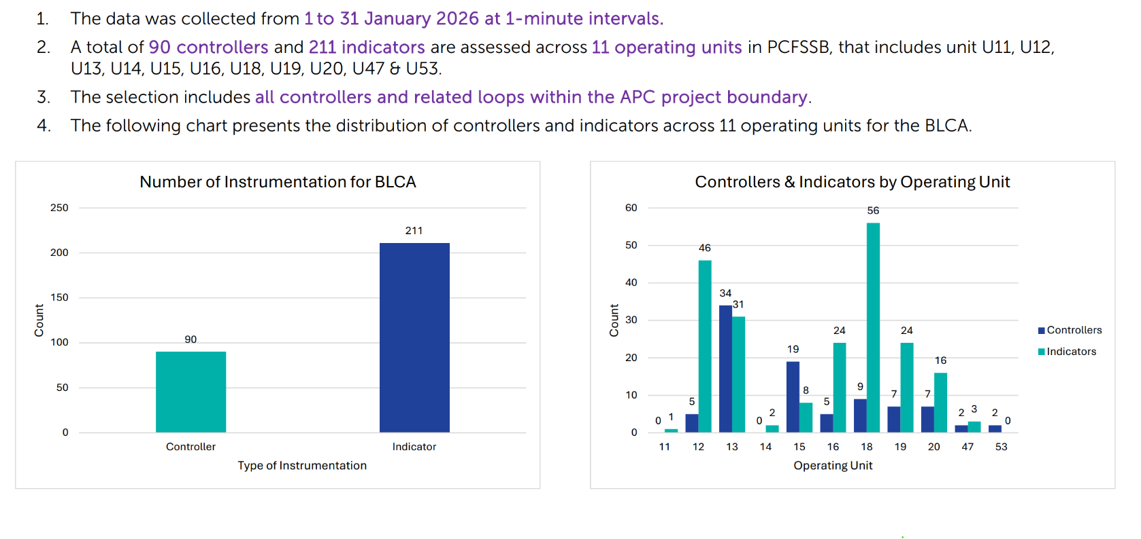
Expected results from BLCA & reported to OPU:
1. Breakdown of Controllers & Indicators
Sample

Slide 38
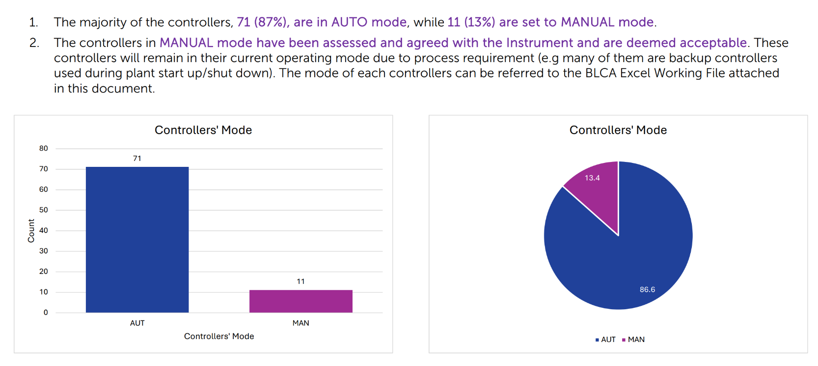
Expected results from BLCA & reported to OPU:
2. Breakdown (%) of Automation
Sample

Slide 39
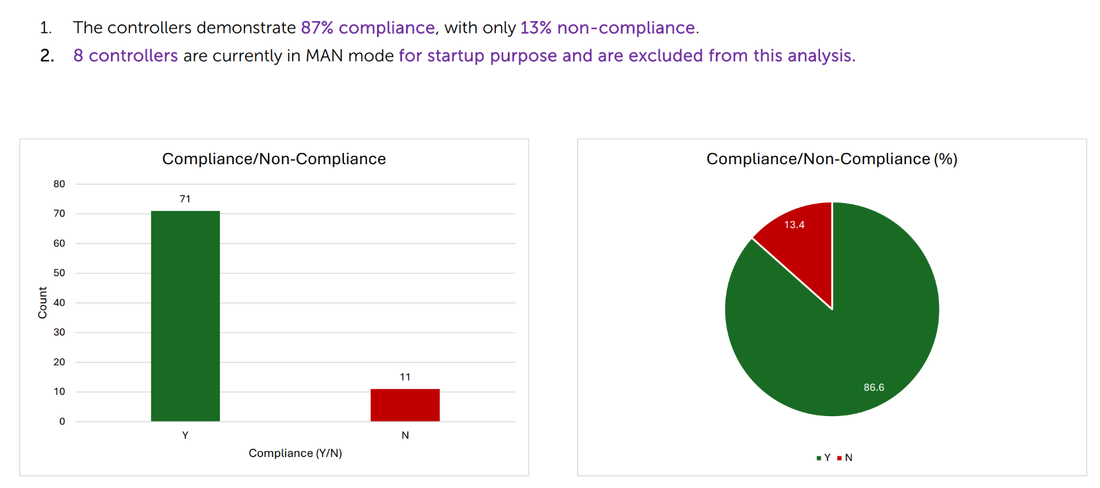
Expected results from BLCA & reported to OPU:
3. Breakdown (%) of Controllers’ Compliance
Sample

Slide 40
Expected results from BLCA & reported to OPU:
3. Breakdown (%) of Controllers’ Compliance
Sample
So, in this case, are the controllers in OPU X ready for APC implementation?

Slide 41
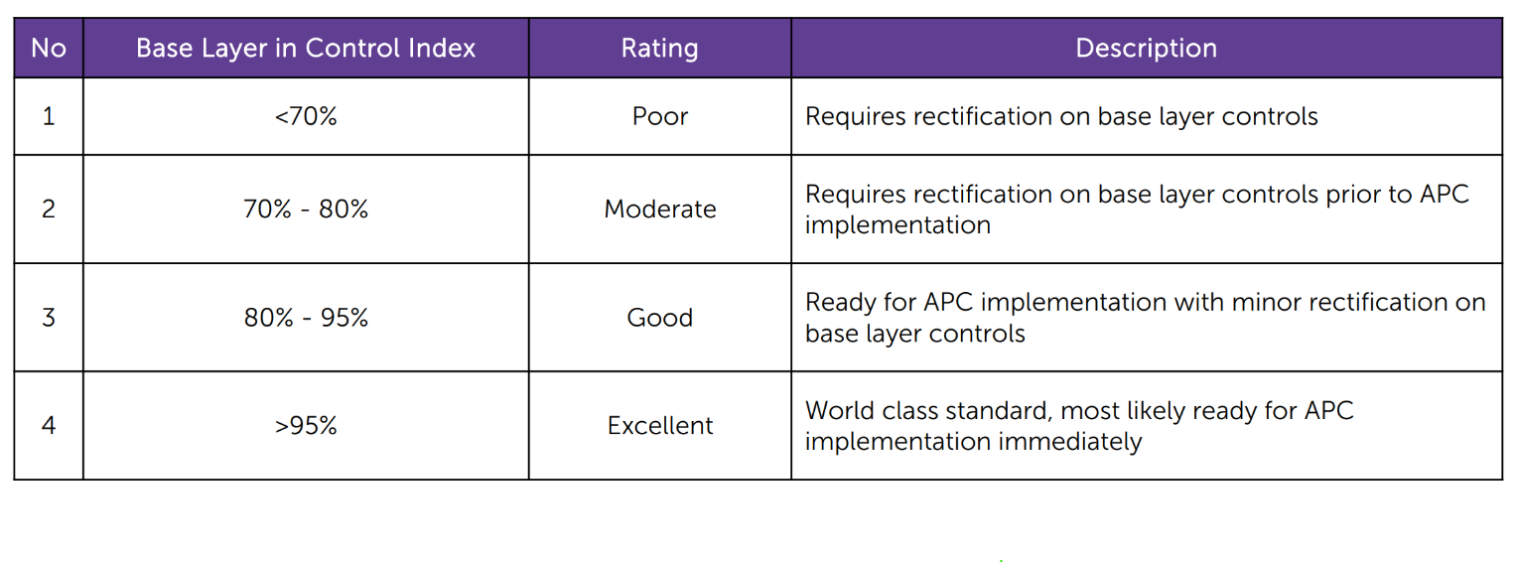
Recap on BLC Index:

Slide 42
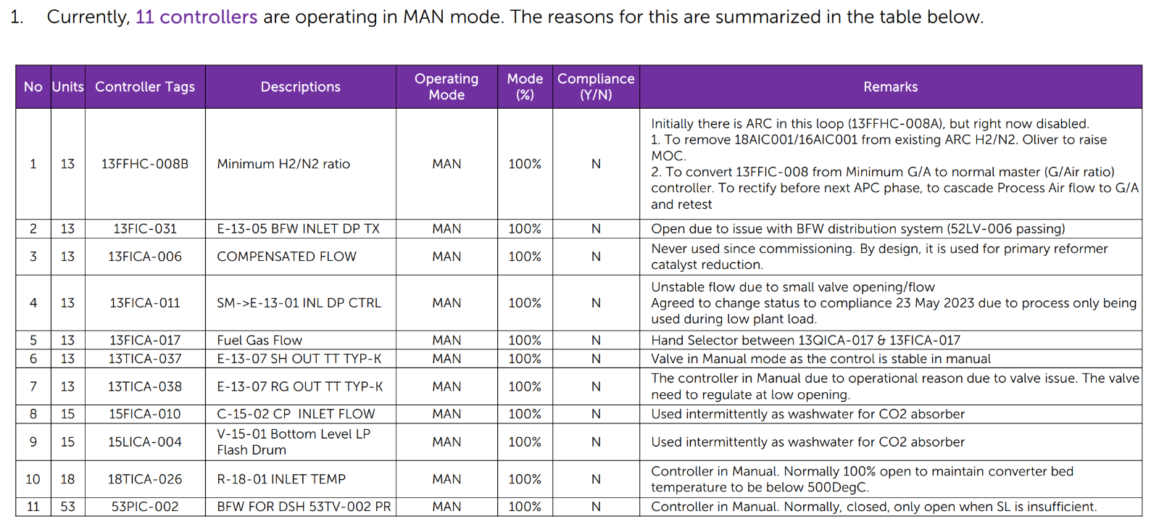
Expected results from BLCA & reported to OPU:
4. Summary of Manual Controllers
Sample

Slide 43
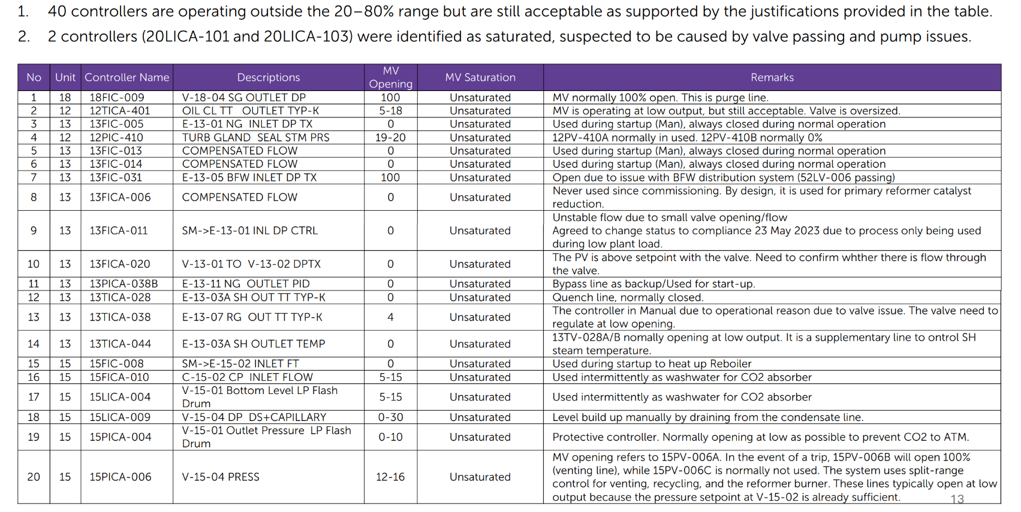
Expected results from BLCA & reported to OPU:
5. Summary of Valve Output Saturation (80% > x > 20%)
Sample

Slide 44
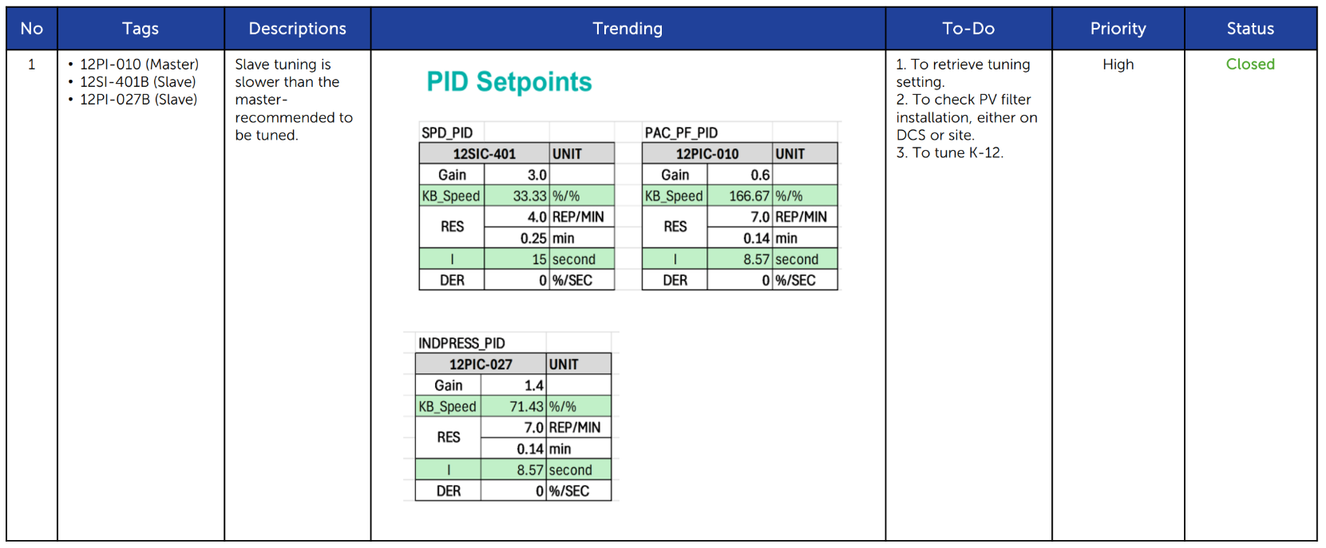
Expected results from BLCA & reported to OPU:
6. Rectification List
Sample

Slide 45
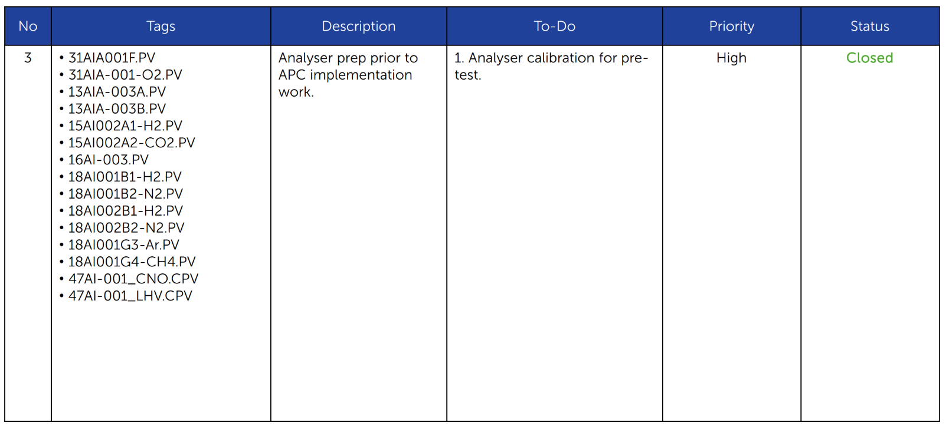
Expected results from BLCA & reported to OPU:
6. Rectification List
Sample

Slide 46
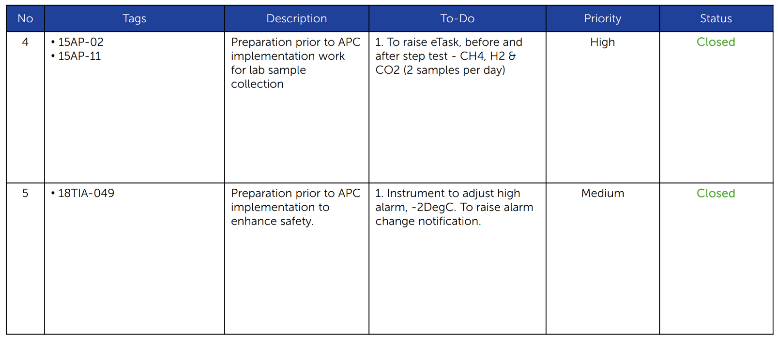
Expected results from BLCA & reported to OPU:
6. Rectification List
Sample

Slide 47
Process Objective
Separate non condensable and volatile low boilers such as Dimethylether (DME), methylformate and solved inert gases from raw methanol received from F-03001.
The non-condensed light ends are vented off the top of Prerun Column Reflux Drum (F-03002).
The column bottom stream, stripped free of light impurities and remaining gas, leaves D-03001 and sent to Pressure Column (D-03002).
Control Objective
030LC1101A: Maintain D-03001 Level at setpoint by manipulating valve opening directly. When level of the column increases, the controller output will ask to open the valve (direct action) and vice versa.
030LC1101B: Maintain D-03001 Level at setpoint by manipulating the outlet flow (FC1107) with feedforward input from feed flow (FC1101). If feed flow increase, the controller will proactively increase the outlet flow according to the target ratio (HC1104).
Either 1 or 2 will be selected to be in controlled one at time. Currently both are nonoperational.
Prerun Column (D-03001) Level Control
Process & Control Objectives
2
1

Slide 48
Cascade control configuration, Level Controller to Flow Controller.
This control scheme allows column level to be controlled steadily (not aggressive) which will also stabilize the flow to the next column.
Master: Level Controller 030LC1101 (New)
030LC1101 is a direct acting controller to control the level D-03001 by manipulating the SV of 030FC1107.
When level exceed SV, controller output will increase RSV to flow controller 030FC1107 and vice versa.
This controller is to be tuned to be less aggressive, such that the flow to next column will experience more gradual change, giving more dynamic stability to the column operations downstream.
Slave: Flow Controller 030FC1107 (Existing)
030FC1107 is a reverse acting controller to control flow rates from bottom outlet of D-03001 due to changes in column level or pressure.
When Flow exceed SV, controller will close the bottom outlet valve to reduce flow and vice versa.
In CAS mode, this controller will receive SV from the master to control the level accordingly.
Prerun Column (D-03001) Level Control
Proposed Control Scheme & Narrative

Slide 49
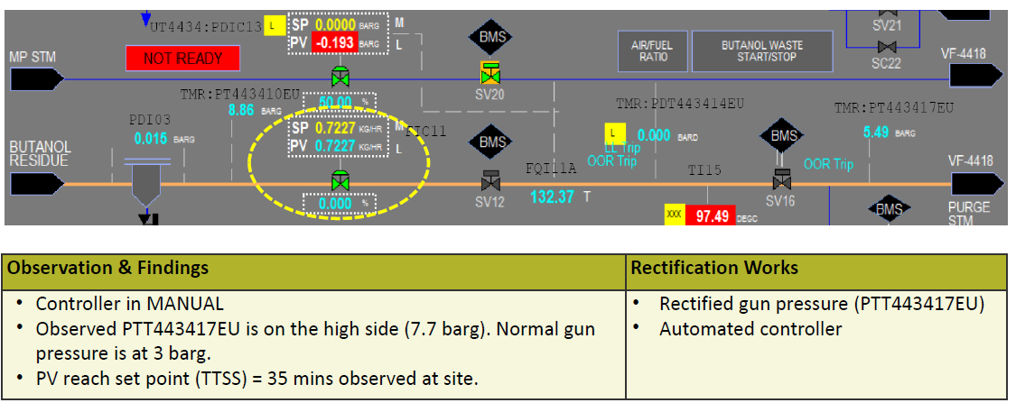
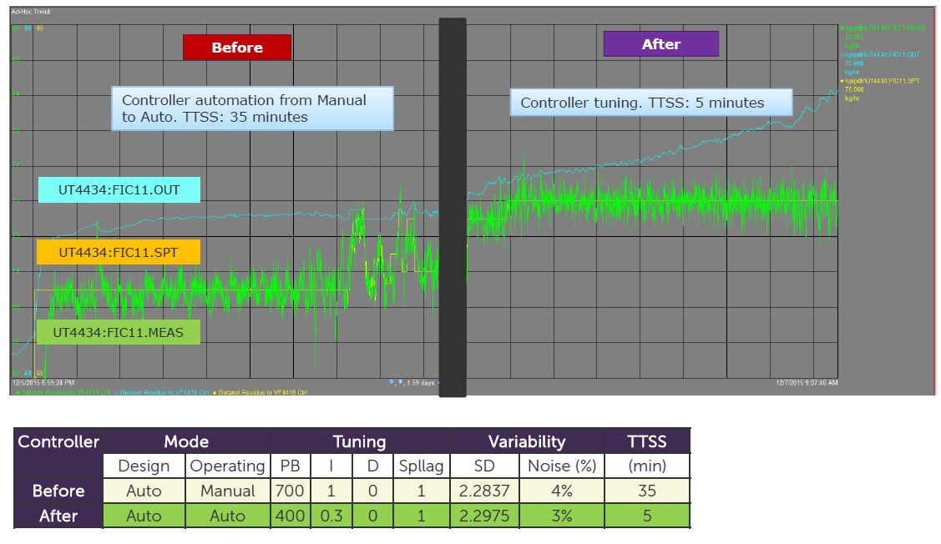
Sample of Process Trending Improvement (if rectification is part of the scope)
Sample of Automation & Fine Tuning

Slide 50
Configuring MDpro for Analysis

Slide 51
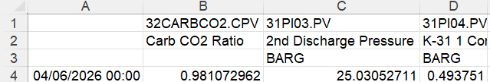
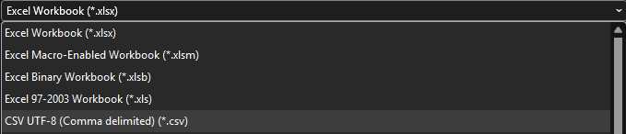
Excel File Formatting
Before loading the data into MDPro software:
Ensure the time of PI data in the format: (dd/mm/yyyy hh:mm)
Ensure you PI tag Data is on row 4 of the excel file, PI tag Descriptors is at row 2 and PI tag Engineering Unit is at row 3
Once the data collection is completed, the file is saved as .csv format

Slide 52
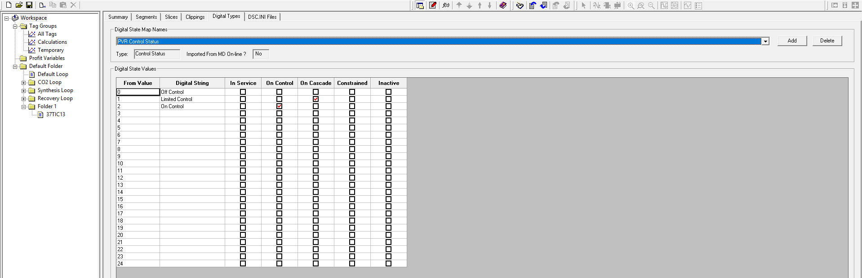
Digital Data Tag Configuration
1
Before loading the data into the software, the digital tags for the data needs to be configured. First, navigate to the ‘Digital Types’ tab in ‘Workspace’ and then click ‘add’.

Slide 53
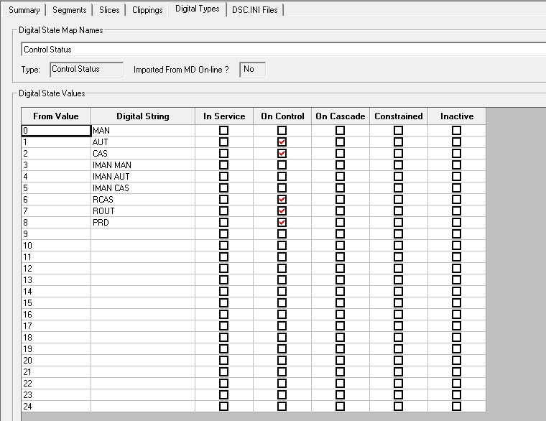
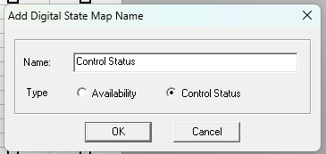
Digital Data Tag Configuration
3
Once step 2 is done, follow and input the configurations below for the new digital state
2
Then name the following tag configuration as “Control Status”: and select the type ‘Control Status’

Slide 54
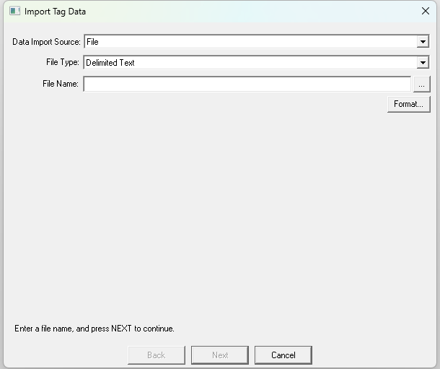
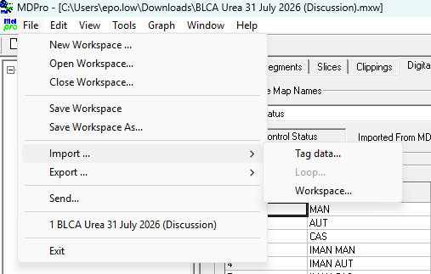
Data Importing
1
2
To import the data tags into MDPro software, navigate to ‘File’ and select ‘import’ then ‘tag data’
After selecting ‘Tag data’, a window like below will pop up. Select the ‘…’ button

Slide 55
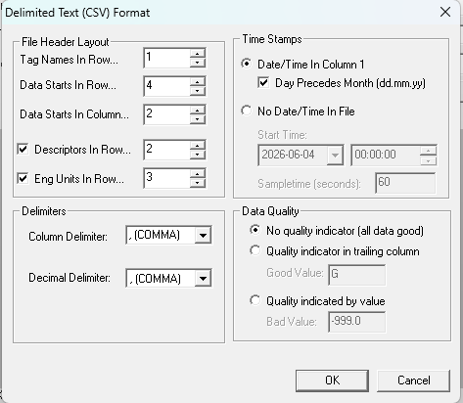
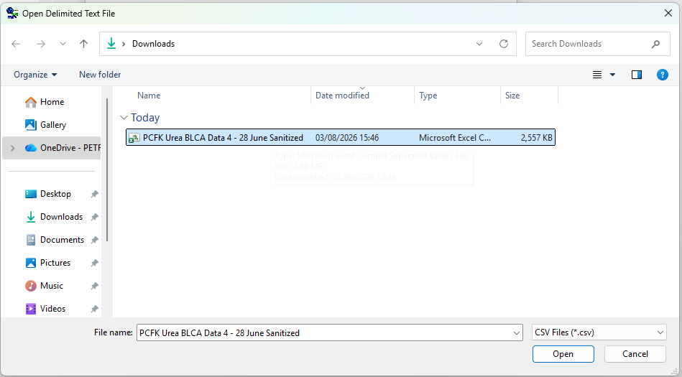
Data Importing
4
3
Once you selected the file, configure the settings for the data format according to the figure below
Then select your data file to load into the software

Slide 56
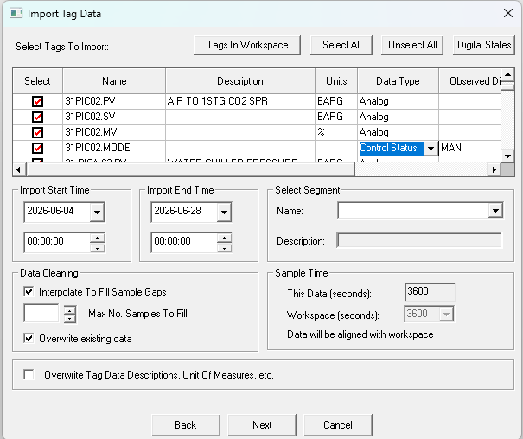
Data Importing
5
Once the format is done, click OK and then a window such as this will pop up
IMPORTANT: Ensure that data tags containing .MODE data type is set at control status

Slide 57
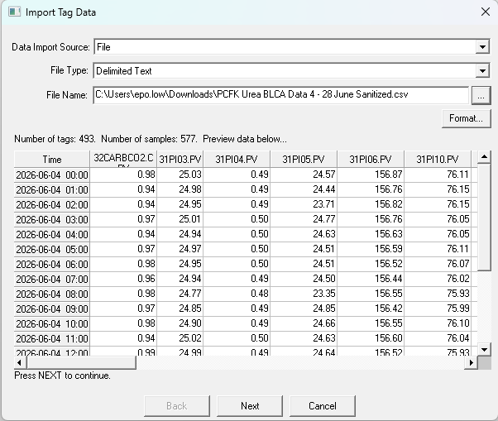
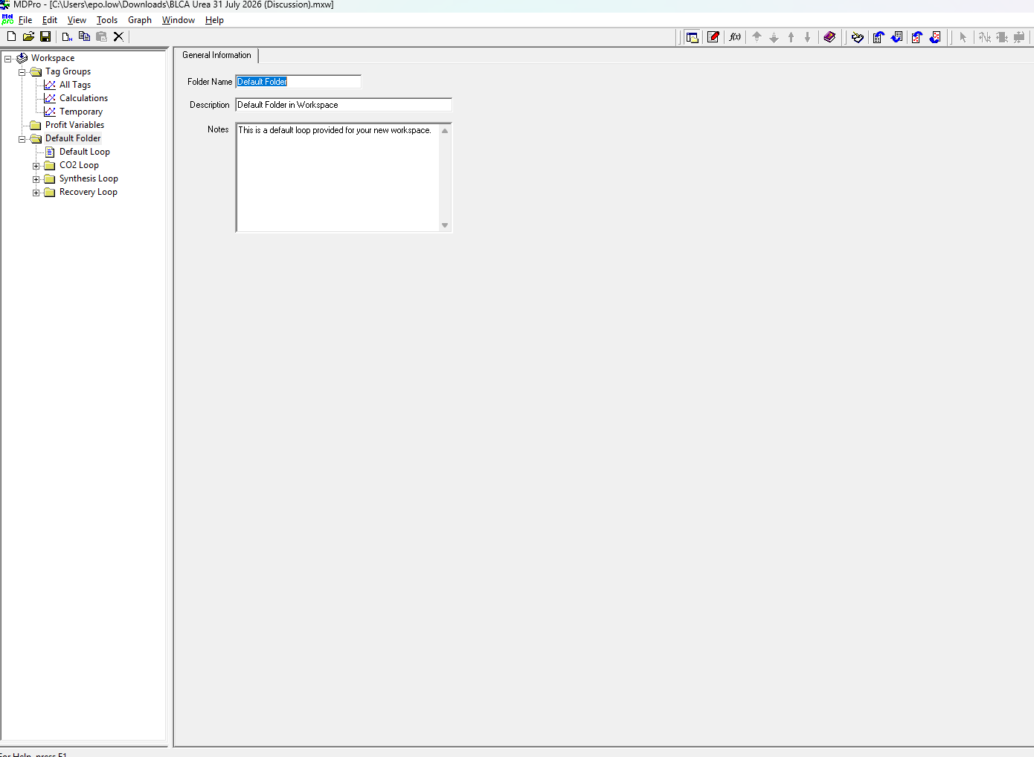
Data Importing
6
7
Once all the .MODE is configured into ‘Control Status’ data type, click okay and a preview of data will pop up
Select Next and this window the import Tag Data window will disappear indicating successful data loading

Slide 58
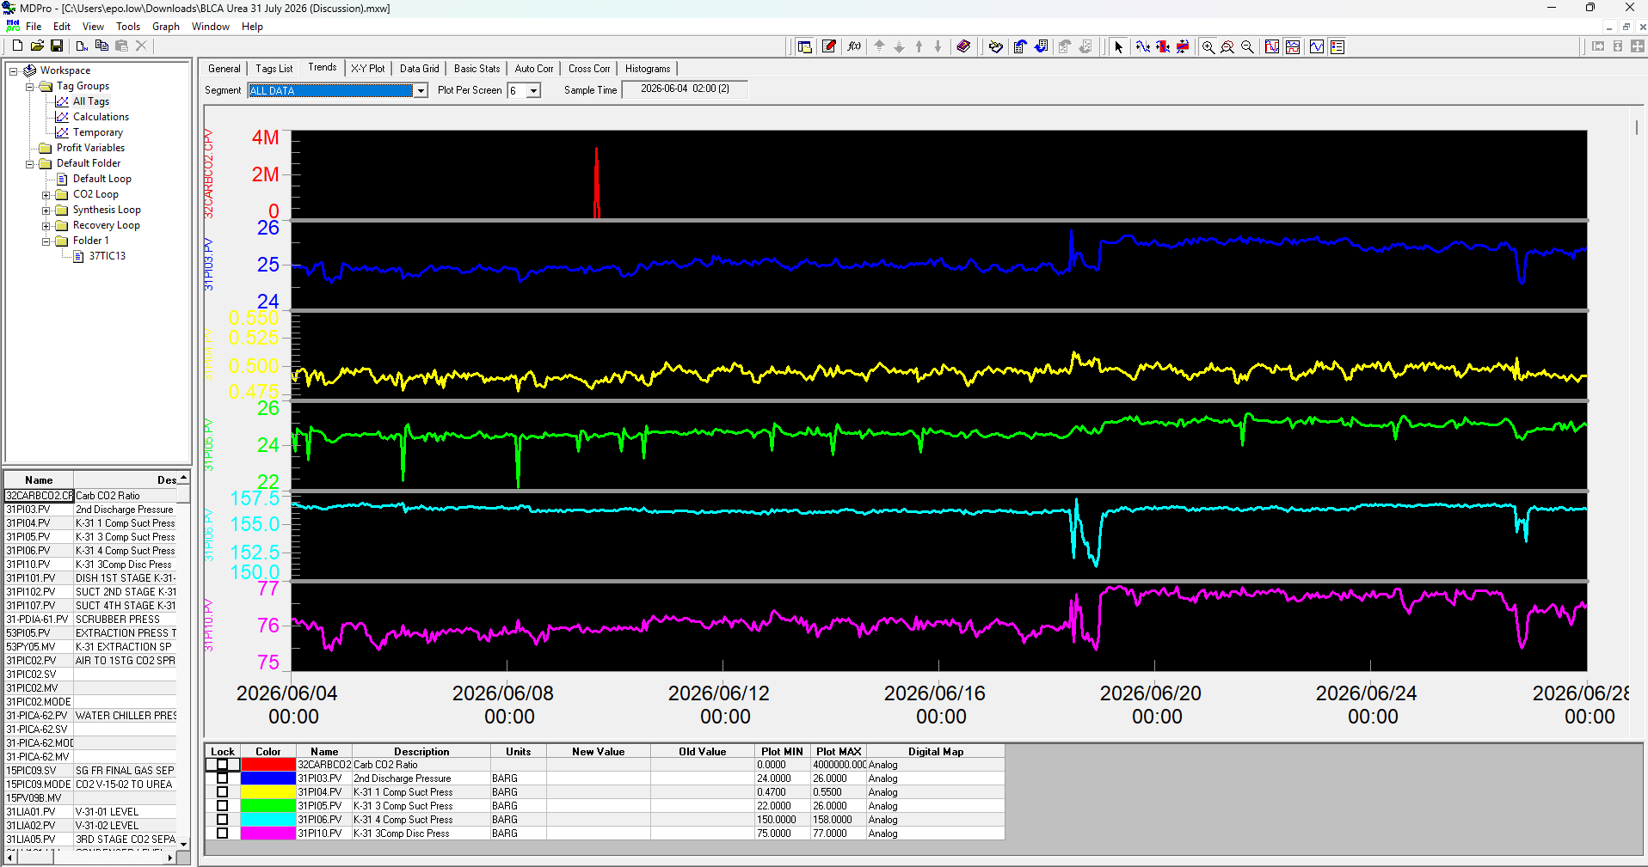
Plot Trend Viewing
1
To view different plot trends, go to ‘Workspace’ and navigate to ‘Trends’

Slide 59
Changing Plot Trend Viewing
2
To change the plot trends, drag the PI tag to the bottom box ‘Name’

Slide 60
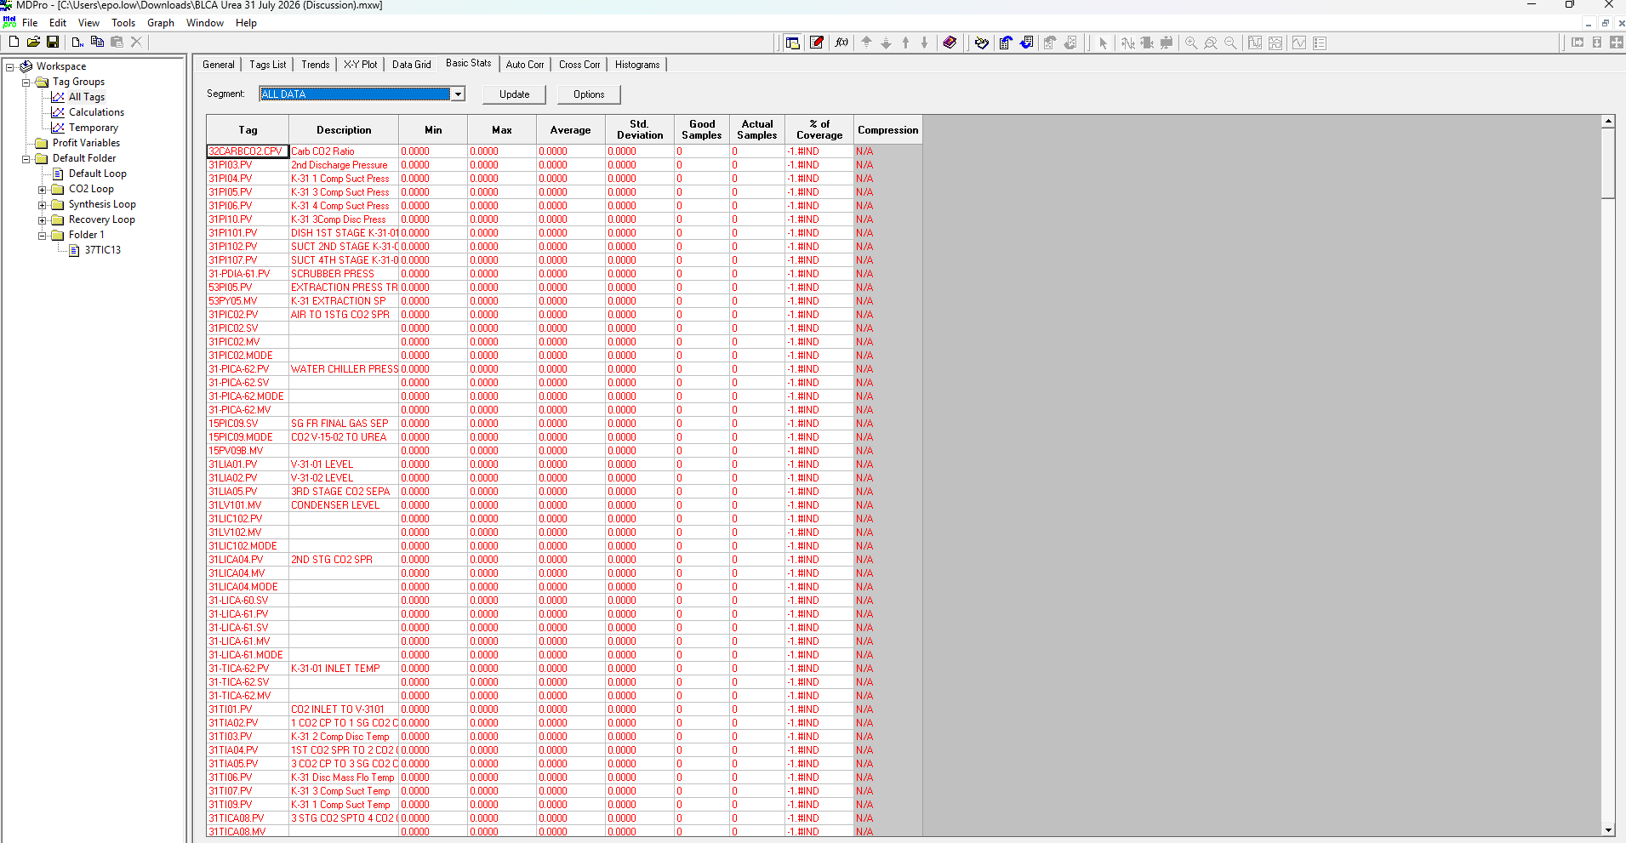
Data Statistics Viewing
1
To view the overall data statistics, go to ‘Workspace’ and navigate to ‘Basic Stats’ and click ‘Update’ to get the up-to-date statistics

Slide 61
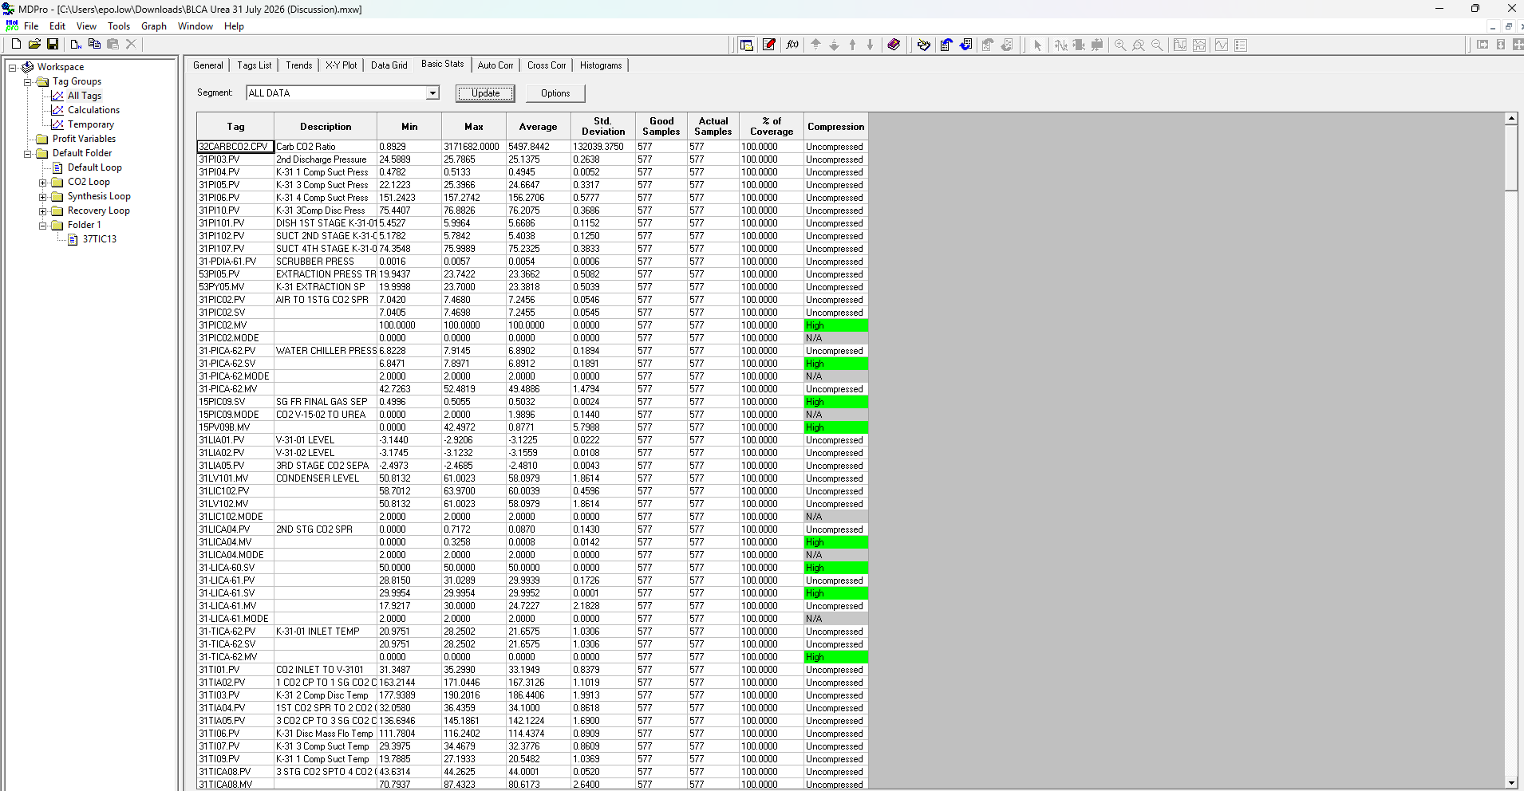
Data Statistics Viewing
2
Once the Data Statistics is updated it will look like this

Slide 62
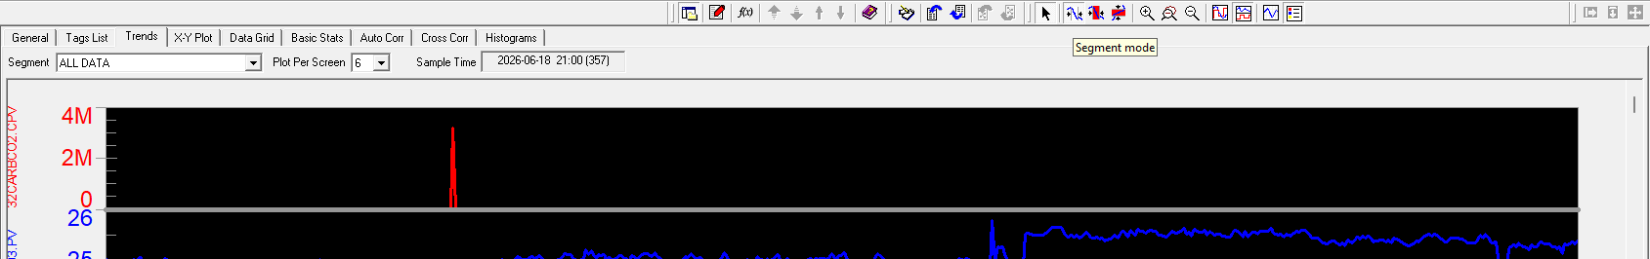
Data Segmentation
1
To segment the date, select the ‘Segment Mode’

Slide 63
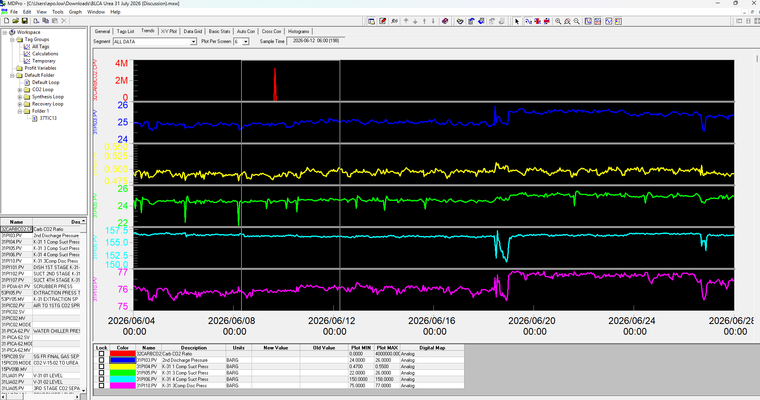
Data Segmentation
2
Once ‘Segment Mode’ is selected, drag the area where you wish to segment and let go

Slide 64
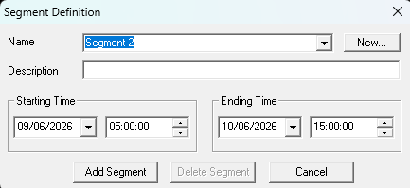
Data Segmentation
3
Once the desired data segment is selected, name the segment and adjust the time segments accordingly

Slide 65
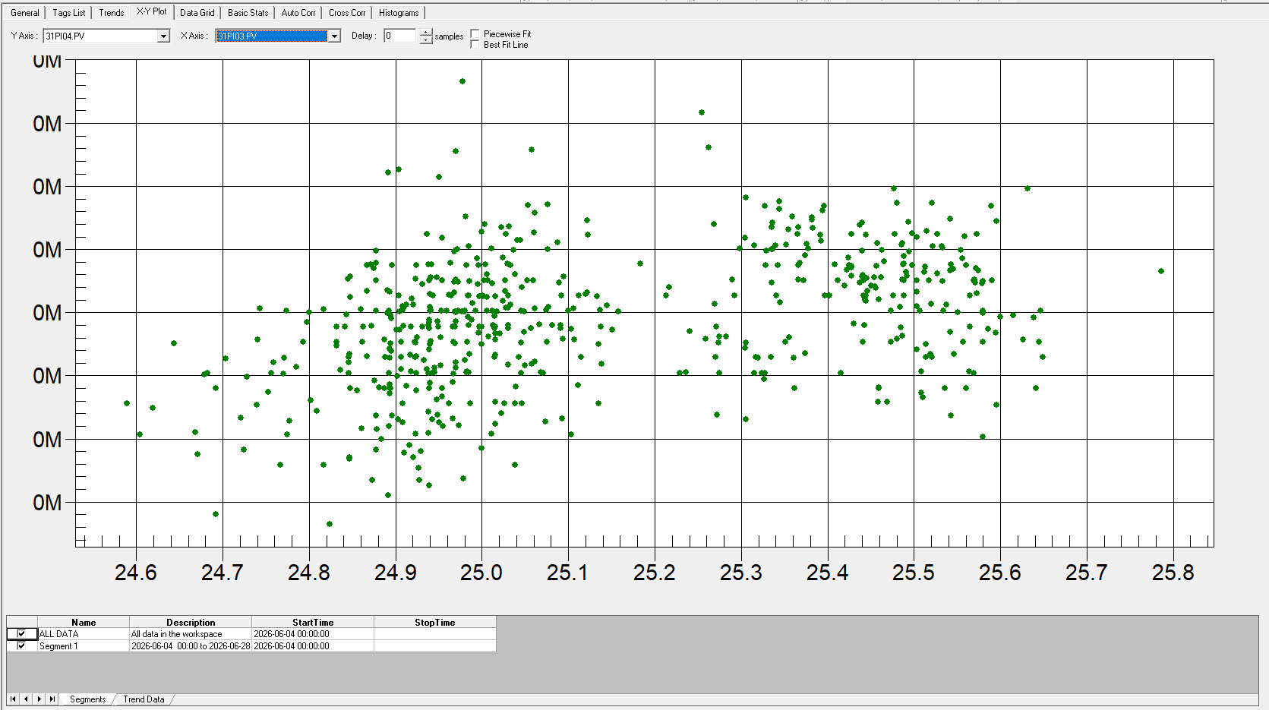
X-Y Plotting
2
To plot the X-Y Plot, select the PI tag for Y axis and X axis to plot the X-Y graph

Slide 66
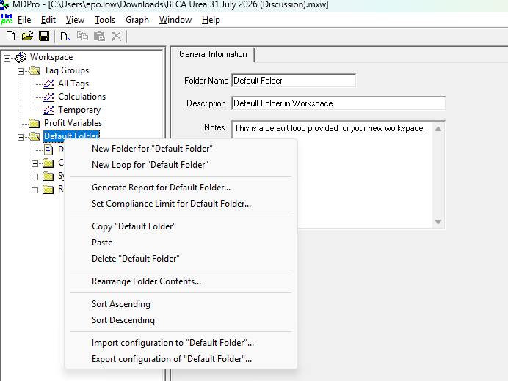
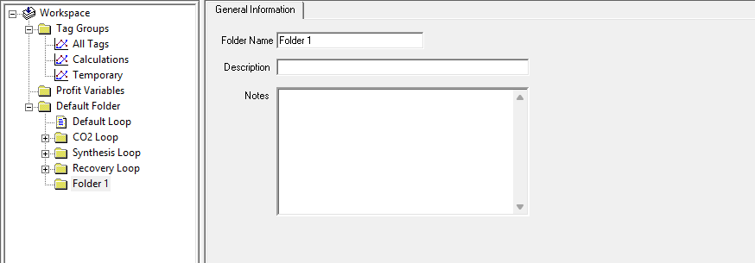
Creating PI Tag folder and PI Tag Loop
1
Before configuring PI Tag Loop, create a new folder to group related loops by right clicking ‘Default folder’ and select ‘New Folder for “Default Folder”’
2
Once the folder is created, name the folder accordingly

Slide 67
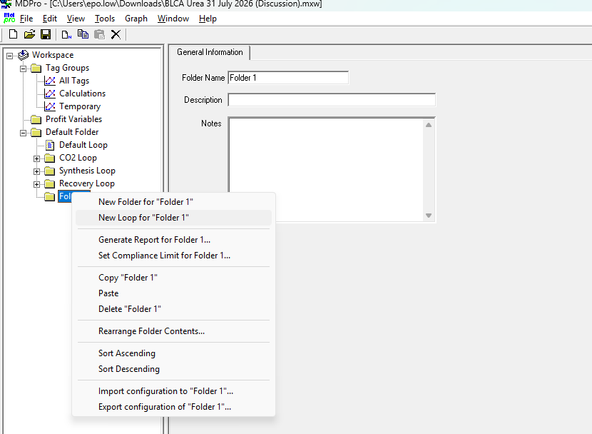
Creating PI Tag folder and PI Tag Loop
3
After naming the folder, create the control loop for controllers by right clicking the ‘Folder 1’ and select ‘New Loop for Folder 1’

Slide 68
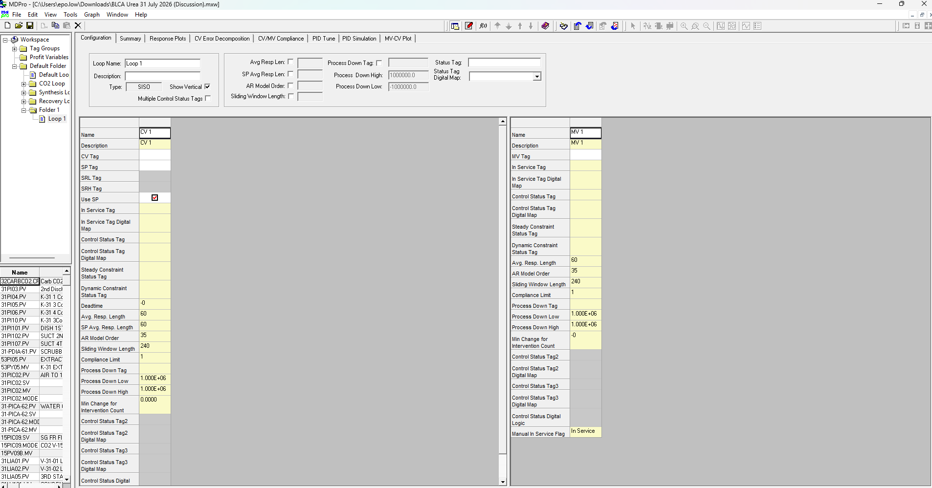
Creating PI Tag folder and PI Tag Loop
4
After creating the new loop, rename the loop and select the ‘Show Vertical’ and to load the data tags into the loop, select the tag browser function

Slide 69
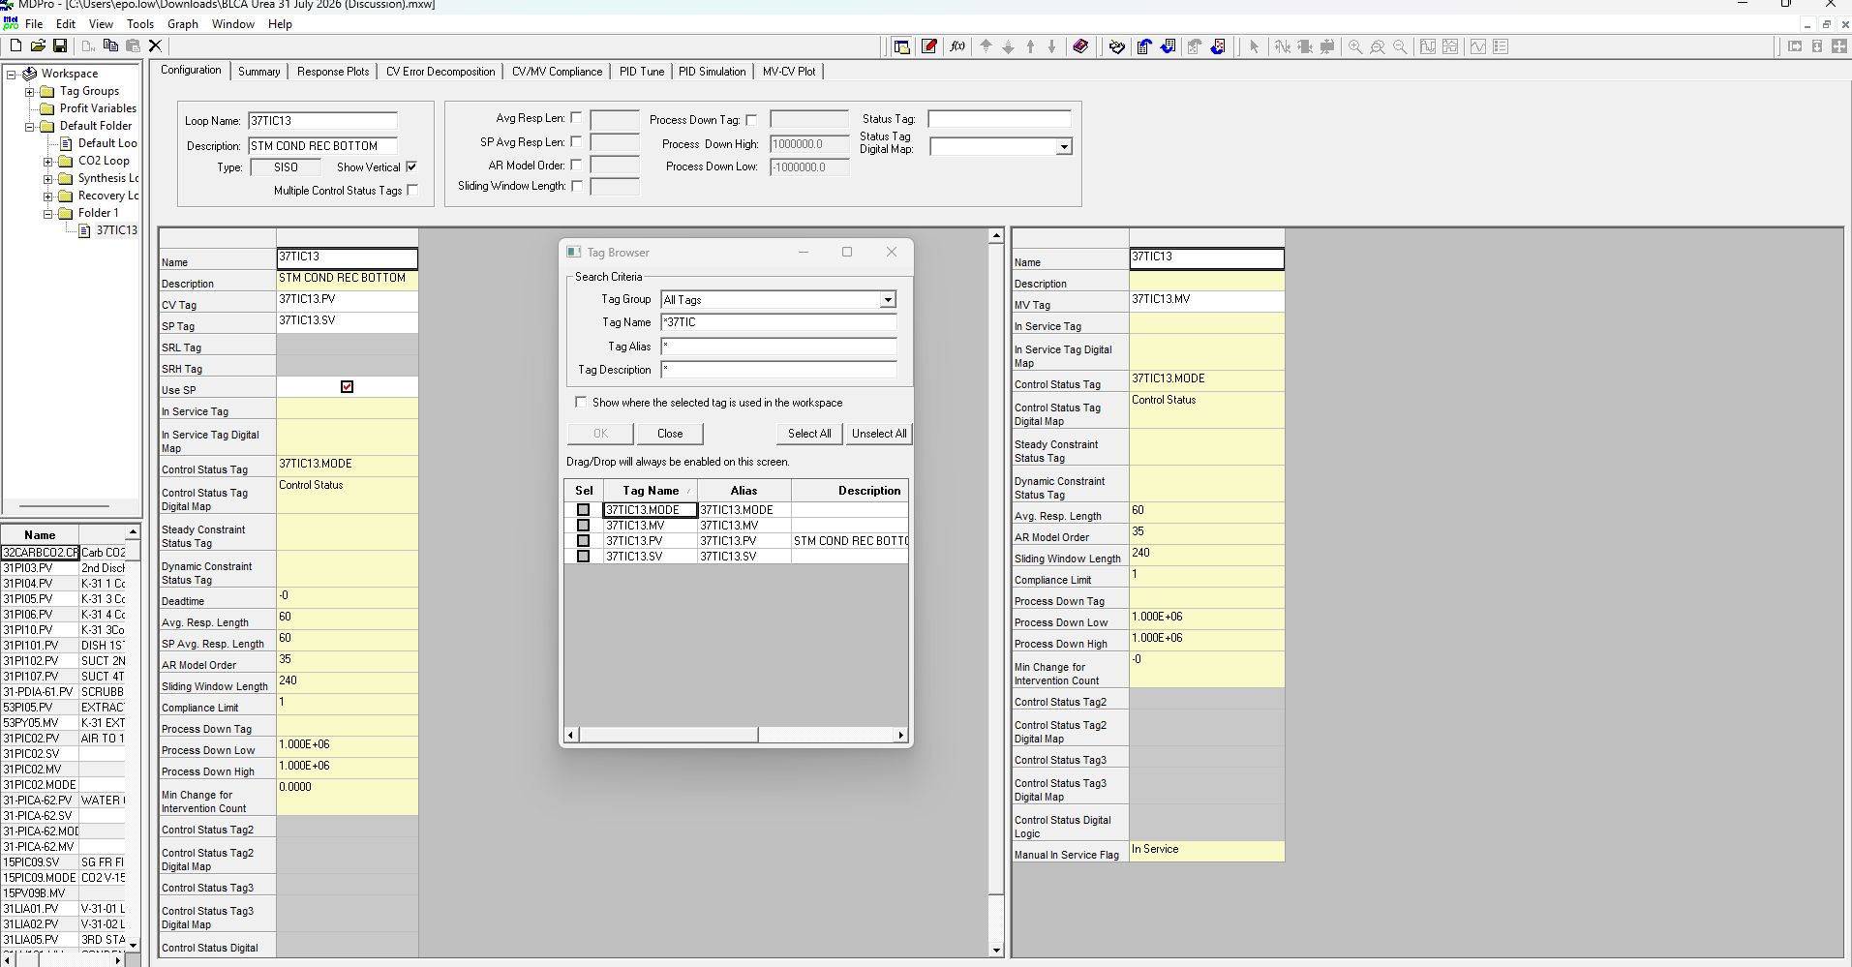
Creating PI Tag folder and PI Tag Loop
5
Once the ‘Tag Browser’ window shows up, enter the controller tag and move the necessary controller tags to the designated area

Slide 70
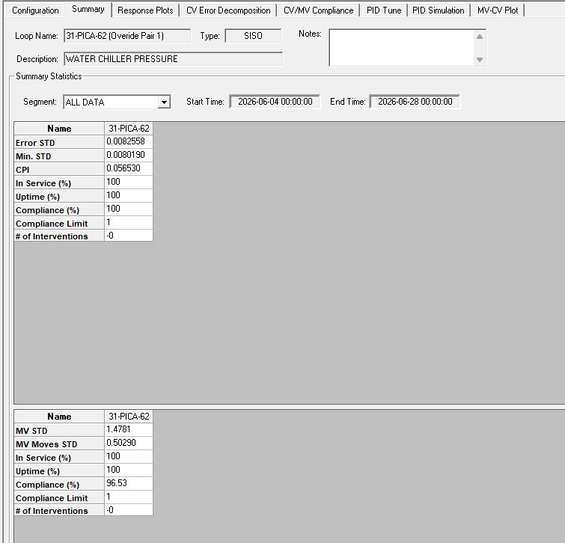
Controller Performance Statistics
6
Once the Controller Tags are successfully configured into the ‘loop’, navigate to ‘Summary’ tab to get extra information such as:
Error STD
Min. STD
CPI
MV STD
Etc.

Slide 71
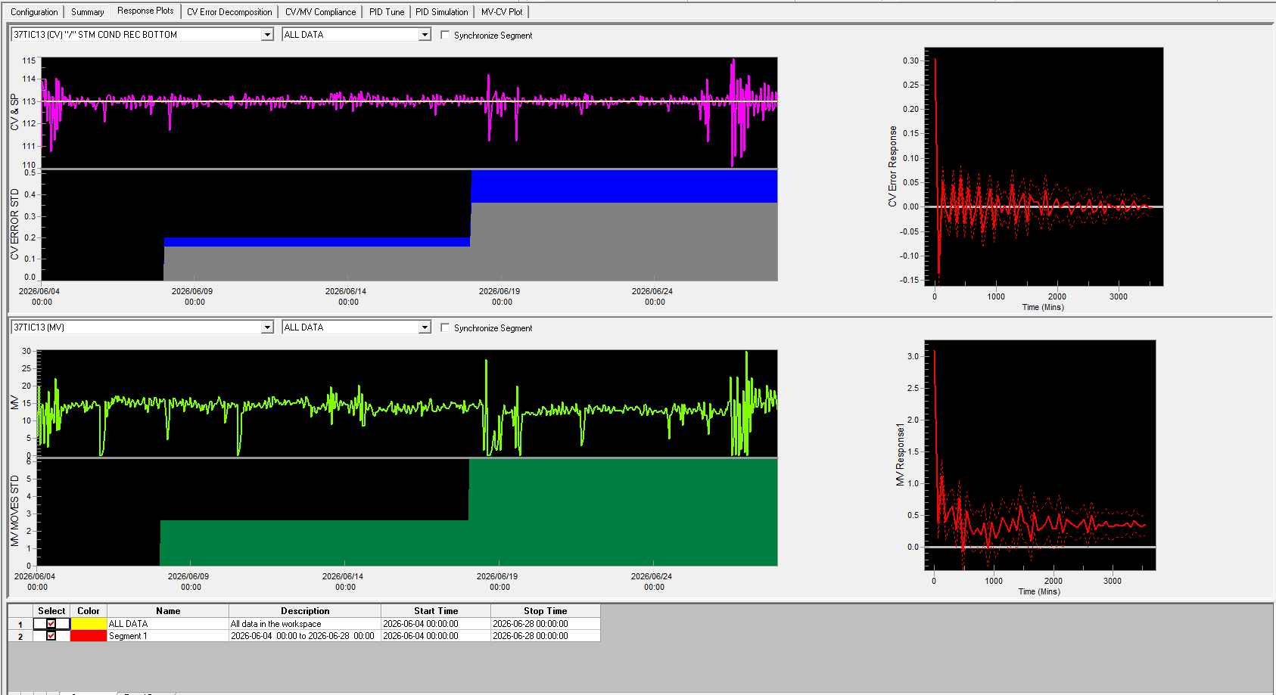
Controller Performance Response Plots
7
To view, the controller performance Response Plots, navigate to ‘Response Plots’ tab

Slide 72
Controller Performance Response Plots

Slide 73
Key take Away ????

Slide 74
PETRONAS
Passionate about Progress

